Slide 1

EDA - Analysis of AMCAT Data

Slide 2
About me
I’m Dhashmitha Nerella. I have completed my graduation in B.Tech in Computer Science & Engineering from Narayana Engineering College.
I'm fascinated by the power of data-driven insights and decision-making, and I believe that data science holds the key to unlocking informed and effective solutions. I desire to combine my programming skills with statistical knowledge to extract meaningful patterns from data.
GitHub Profile
LinkedIn Profile

Slide 3
Business Problem
The increasing demand for Computer Science Engineering graduates in India has created the need to understand salary trends in the field. Companies, students, and educators need data-backed insights into how factors such as degree, specialization, and gender influence salaries. This project aims to analyze salary data to validate the claims made by the Times of India about fresh graduates' salary ranges.
Objective
This project aims to perform a thorough Exploratory Data Analysis (EDA) on a dataset containing salary and other details of Computer Science graduates. We aim to Validate whether fresh graduates in relevant roles earn between ₹2.5-3 lakhs per annum as claimed by the Times of India.

Slide 4
Summary of the Data
The dataset consists of columns that include:
Salary (target variable): Annual salary of graduates.
Degree: Educational qualification (e.g., B.Tech/B.E., M.Tech, etc.).
Specialization: Field of study (e.g., Computer Science, Mechanical Engineering).
Designation: Job title (e.g., Programmer Analyst, Software Engineer).
Gender: Male or Female.
Quant, English, Logical scores: Test scores that might influence employability and salary.
Data Statistics:
Dataset contains X number of rows and Y columns.
Missing Values: Columns like salary had some missing values that were handled during data cleaning.
Outliers: Salary outliers were identified and removed to improve the analysis accuracy.

Slide 5
Exploratory Data Analysis (EDA)
Outlier Removal:
Removed extreme outliers in the salary column where salaries exceeded ₹15,00,000, as these values were deemed unrealistic for fresh graduates.
Aggregating Data:
Grouped data by degree and specialization to analyze trends. For example, aggregated the mean salary for each specialization and degree.

Slide 6
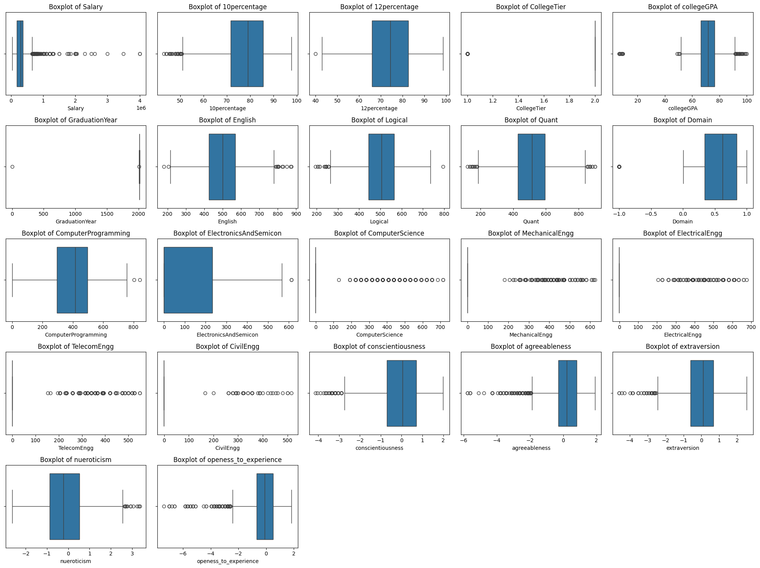
Univariate Analysis
Boxplots for Key Variables:
The boxplots revealed the presence of outliers in several variables, especially salary. The central tendencies of test scores like Quant and Logical were also visualized.

Slide 7
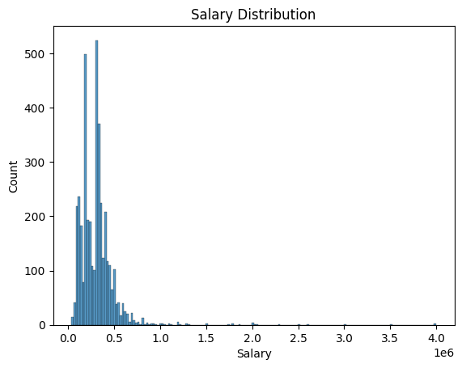
For Numerical Data
Salary Distribution
The histogram displays the salary distribution for the dataset of Computer Science Engineering graduates. The distribution is right-skewed, meaning that the majority of salaries are concentrated at the lower end (around ₹0.2-₹0.5 million per annum).

Slide 8
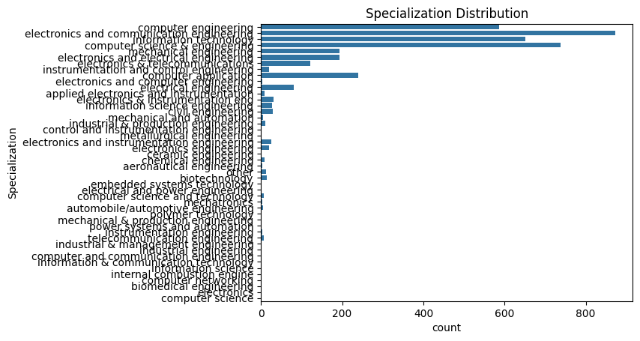
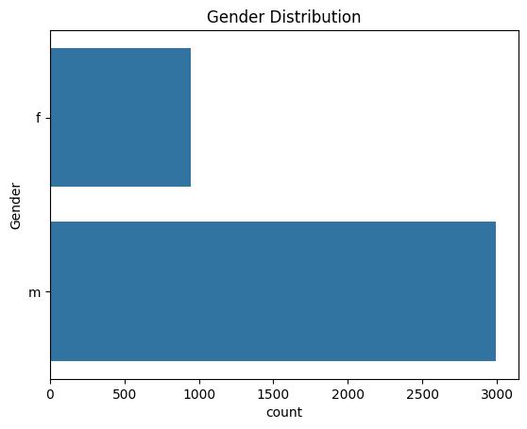
For Categorical Data
Gender Distribution
Specialization Distribution
The majority of graduates are from the Computer Science & Engineering stream, followed by Electronics and Telecommunications. Mechanical, Electrical, and Civil Engineering have fewer graduates.
There is a notable gender gap, with males making up the majority of graduates in the dataset.

Slide 9
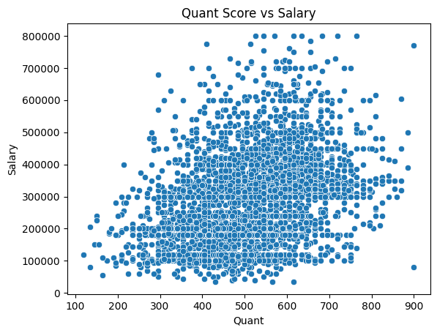
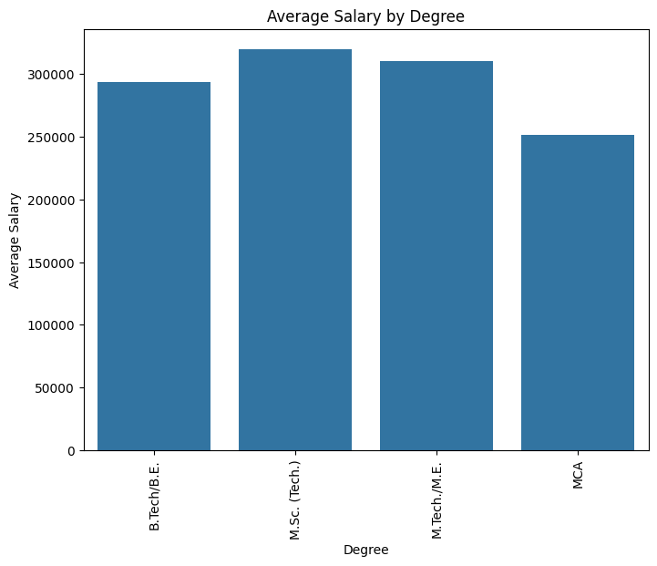
Bivariate Analysis
Quant Score vs Salary
Average Salary by Degree
The scatterplot shows a positive but weak correlation between Quant scores and salary. As Quant scores increase, salaries tend to rise, but the relationship is not very strong.
The bar plot shows that M.Sc. (Tech.) graduates earn the highest average salary, followed by M.Tech./M.E. and B.Tech/B.E. graduates. MCA degree holders have the lowest average salary.

Slide 10
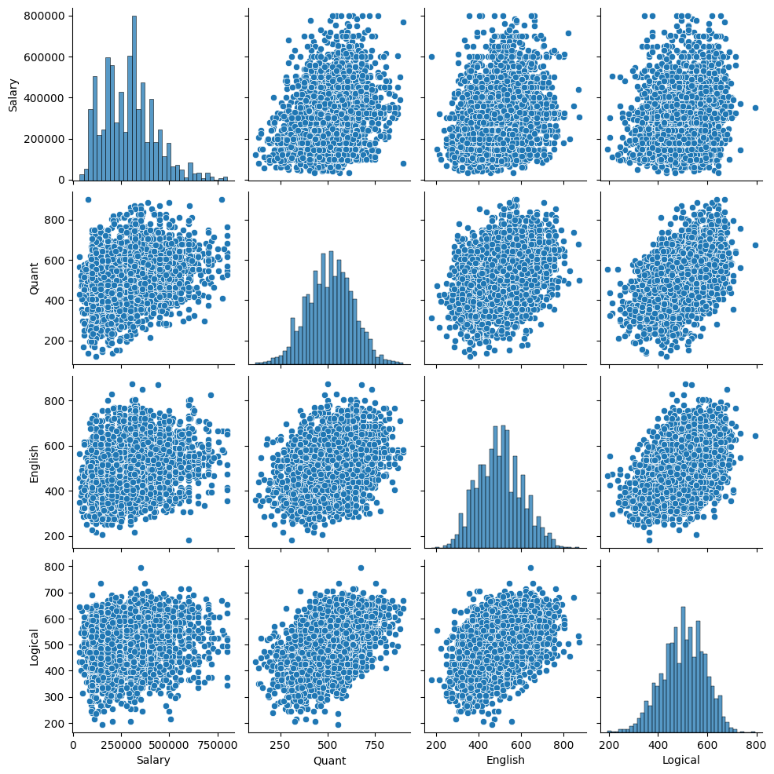
Pair Plot
There is a slight positive correlation between all pairs, especially between Quant and Logical scores, and Quant and English scores. Distributions of individual variables show that Salary is right-skewed, while Quant, English, and Logical scores are more normally distributed.

Slide 11
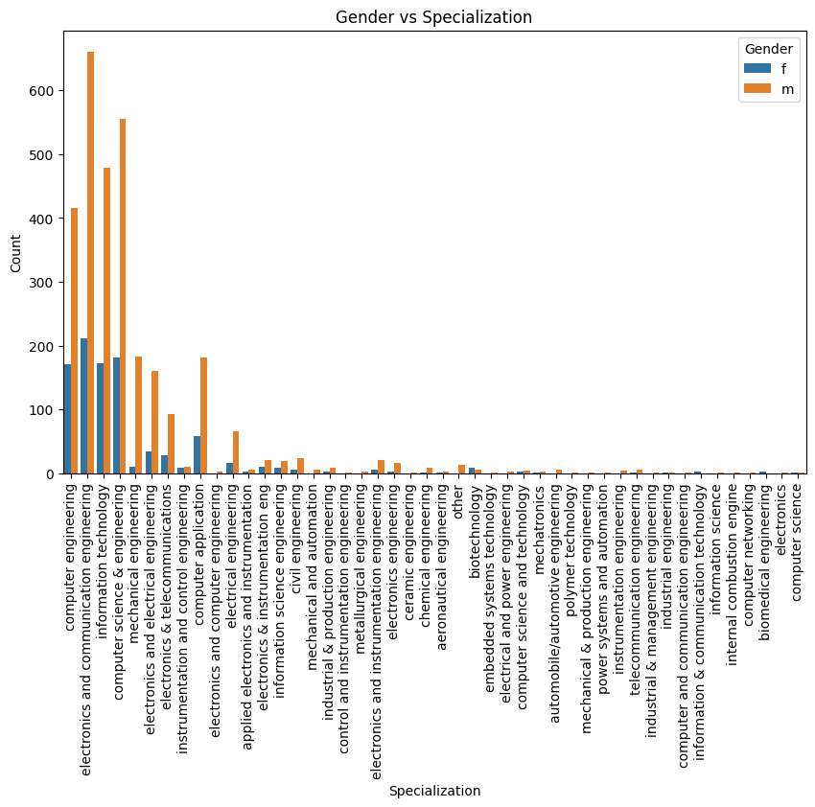
Gender vs Specialization
The countplot visually demonstrates the distribution of specializations among different genders, highlighting any disparities or patterns.

Slide 12
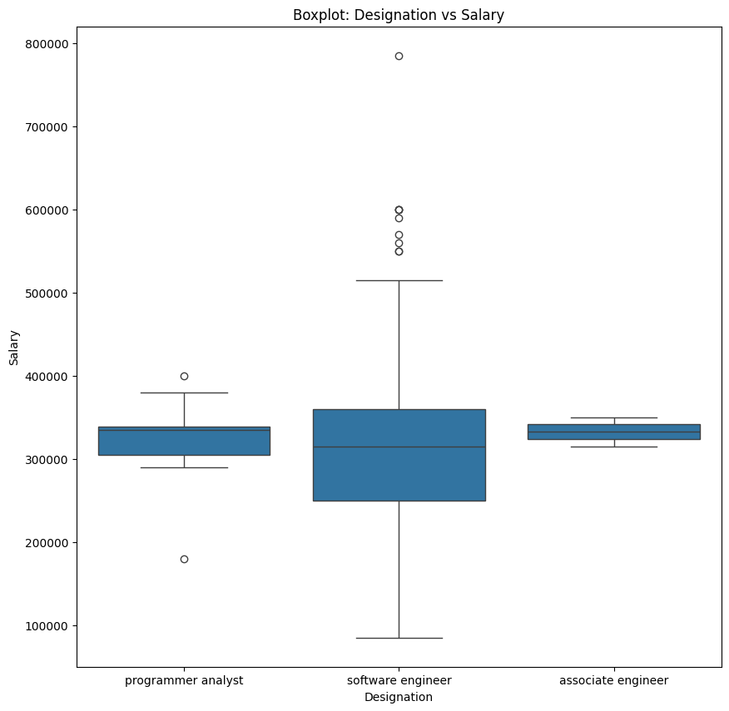
Key Business Question
Research Question:
The Times of India article dated Jan 18, 2019, claims that fresh Computer Science Engineering graduates working as Programming Analysts, Software Engineers, Hardware Engineers, or Associate Engineers can earn between ₹2.5 to 3 lakhs per annum.

Slide 13
Conclusion
The exploratory data analysis (EDA) conducted on the salary trends of Computer Science Engineering graduates in India provided several key insights into the factors influencing salaries in this domain. The analysis validated the claim from the Times of India regarding the salary expectations for fresh graduates in roles such as Programmer Analysts and Software Engineers, with average salaries falling within the expected range of 2.5-3 lakhs per annum.
The salary distribution exhibited a right-skewed pattern, indicating that while many graduates earn lower salaries, a significant number achieve higher compensation, possibly due to a few high-paying roles.

Slide 14

THANK YOU

